Slide 1
Linear Algebra

Slide 2
What is Linear Algebra?
Linear algebra is a branch of mathematics that deals with linear equations and their representations in the vector space using matrices
Example: 7 cups of coffee and 4 pieces of toast cost ₹655. 5 cups of coffee and 3 pieces of toast cost ₹475. Find the cost of each item?
7x + 4y - 655 = 0
5x + 3y - 475 = 0
7 4
5 3
655
475

Slide 3
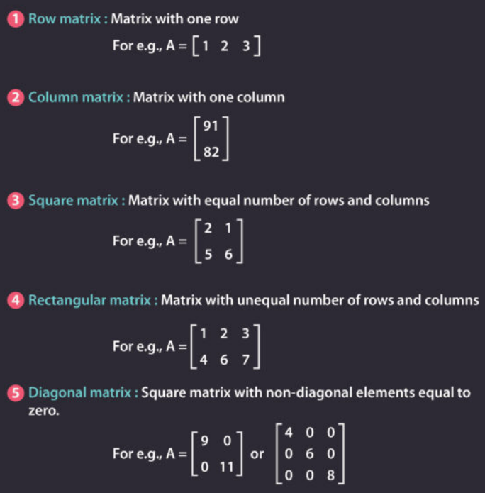
Types of Matrix

Slide 4
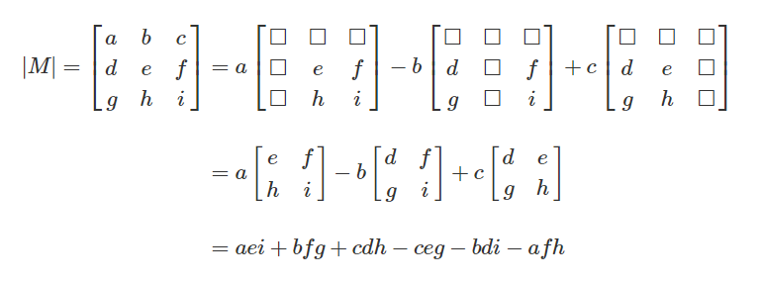
1.a Square Matrix-Determinant
A square matrix is an n×n matrix; that is, it has the same number of rows as columns. The determinant is an important property of square matrices.
Similarly, in the case of a 3×3 matrix, the determinant is:

Slide 5
Determinant of a Matrix

Slide 6
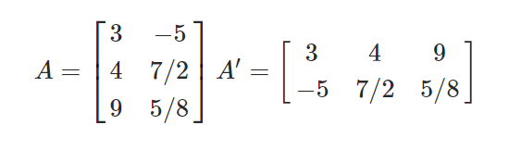
1.b Square Matrix-Transpose
If A = [a_{ij}] be an m × n matrix, then the matrix obtained by interchanging the rows and columns of A would be the transpose of A.
It is denoted by A′ or (A^{T}).

Slide 7
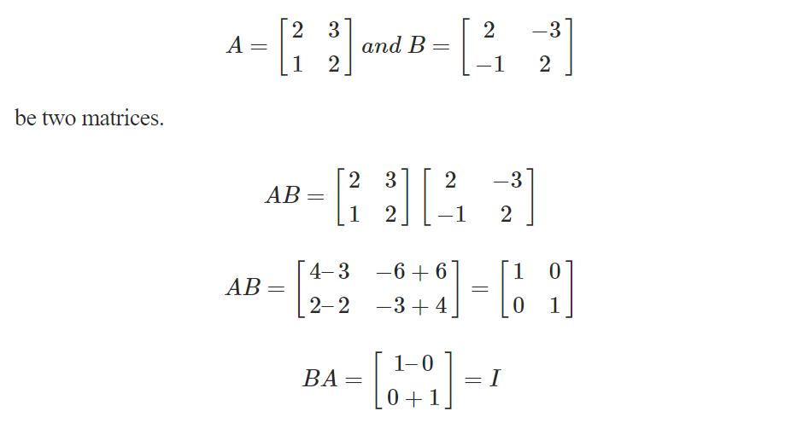
1.c Square Matrix-Inverse
If A is a square matrix of order m, and if there exists another square matrix B of the same order m, such that AB = BA = I,
then B is called the inverse matrix of A and it is denoted by A^{–1}

Slide 8
Eigen Value and Eigen vector

